Slide 1
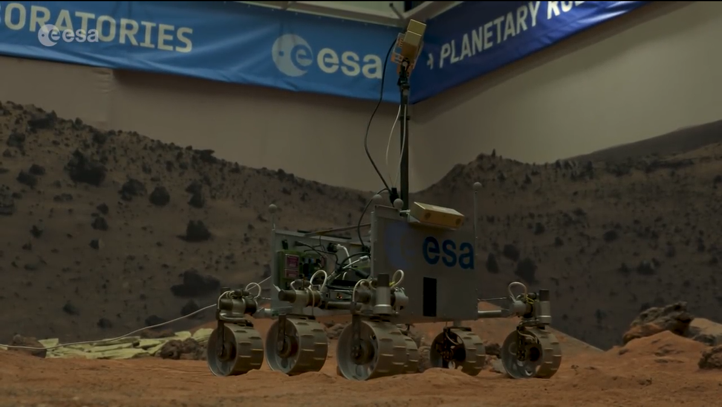
CAMERA FRAME
BODY FRAME

Slide 2
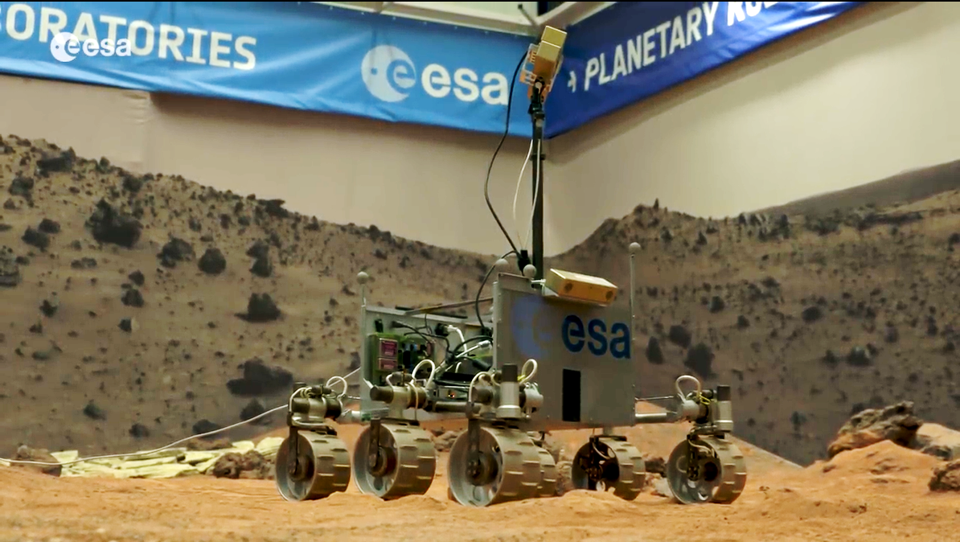
CAMERA FRAME
BODY FRAME

Slide 4
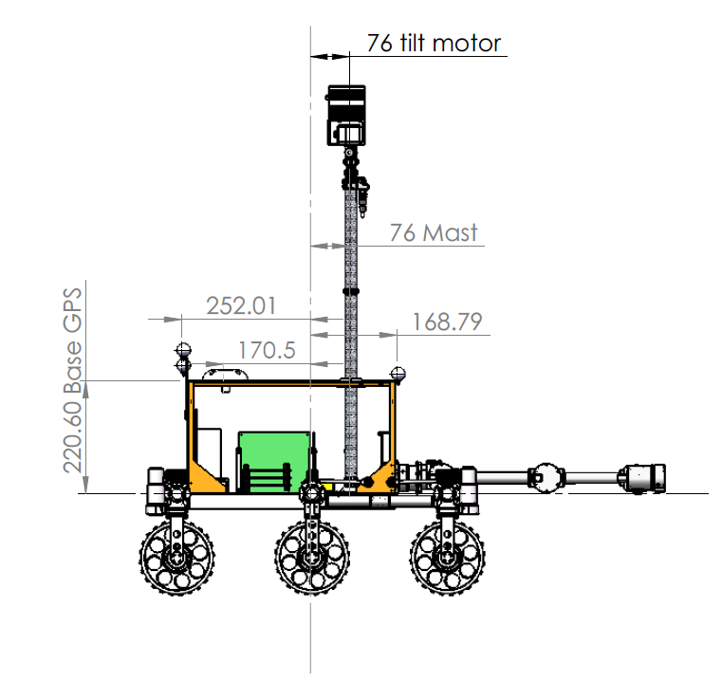
ODOMETRY FRAME
CAMERA FRAME
BODY FRAME

Slide 5
GRAVITY
CAMERA FRAME
BODY FRAME
ODOMETRY FRAME
WORLD FRAME
PITCH

Slide 6
GRAVITY
CAMERA FRAME
BODY FRAME
IMU FRAME
ODOMETRY FRAME
WORLD FRAME

Slide 7
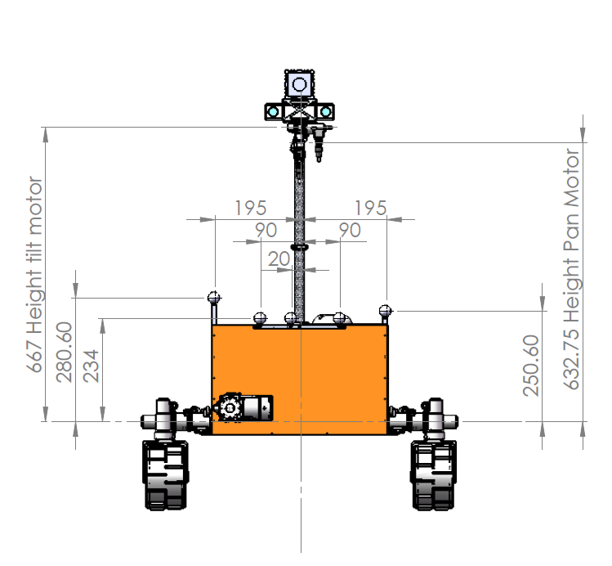
CAMERA FRAME
BODY FRAME

Slide 8
GRAVITY
CAMERA FRAME
BODY FRAME
ODOMETRY FRAME
ROLL
WORLD FRAME

Slide 9
GRAVITY
CAMERA FRAME
BODY FRAME
IMU FRAME
ODOMETRY FRAME
WORLD FRAME

Slide 10
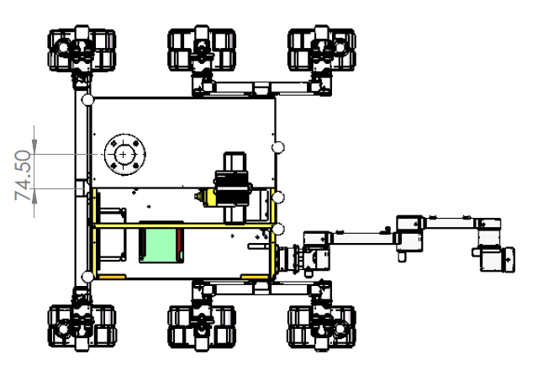
BODY FRAME
CAMERA FRAME

Slide 11
BODY FRAME
IMU FRAME
CAMERA FRAME
ODOMETRY FRAME

Slide 12
BODY FRAME
ODOMETRY FRAME
CAMERA FRAME

Slide 13
Z
Y
X
FRAME CONVENTION

Slide 14






Frame k+1
$$b_{ov}$$
OVERLAP AREA
OVERLAP AREA
$$l_{ov}$$
$$c_{ov}$$
$$c_{ov}$$
$$l_{ov}$$
θ
Frame k
$$a_{ov}$$
b
frame
pitch
c
camera
a
l2
VFOV
l2
h
l1
g
HFOV
l1
frame
g
c

Slide 15
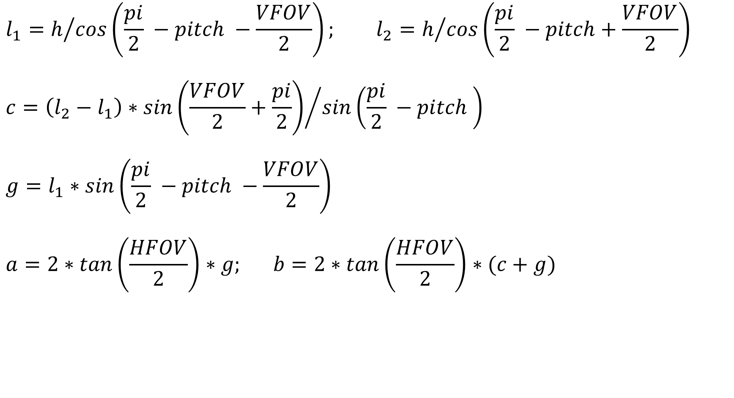
$$l_{1}=h/{cos\left(\frac{pi}{2} −pitch −\frac{VFOV}{2}\right); l_{2}=h/{cos\left(\frac{pi}{2} −pitch+\frac{VFOV}{2}\right)}}$$
$$c={\left(l_{2}−l_{1}\right)∗sin\left(\frac{VFOV}{2}+\frac{pi}{2}\right)}/{sin\left(\frac{pi}{2} −pitch \right)}$$
$$g=l_{1}∗sin\left(\frac{pi}{2} −pitch −\frac{VFOV}{2}\right)$$
$$a=2∗tan\left(\frac{HFOV}{2}\right)∗g; b=2∗tan\left(\frac{HFOV}{2}\right)∗(c+g)$$

Slide 16
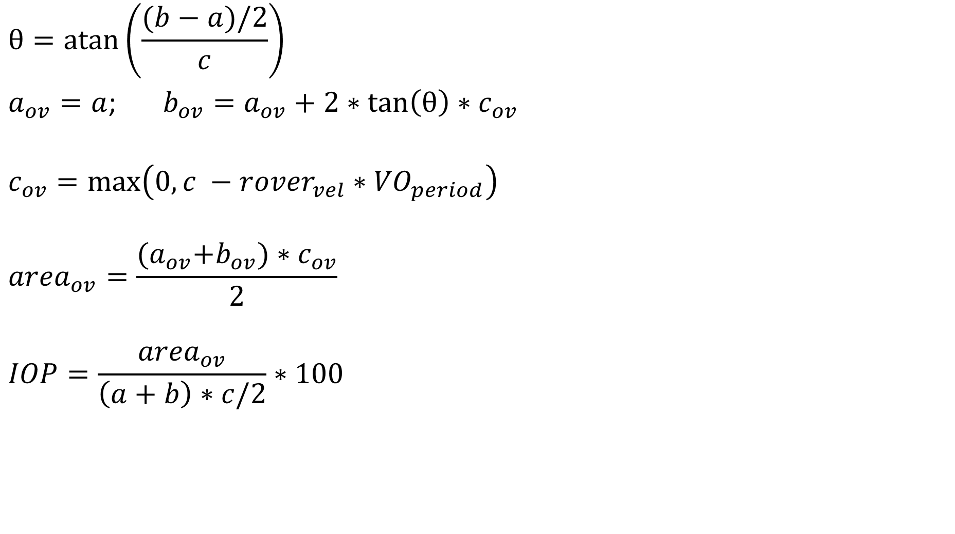
$$θ=atan⁡\left(\frac{(b−a)/2}{c}\right)$$
$a_{ov}=a$; $b_{ov}=a_{ov}+2∗\tan\left(θ\right){∗c}_{ov}$
$$c_{ov}=\max\left(0, c −{rover}_{vel}∗{VO}_{period}\right)$$
$${area}_{ov}=\frac{{(a}_{ov}+b_{ov})∗c_{ov}}{2}$$
$$IOP=\frac{{area}_{ov}}{\left(a+b\right)∗c/2}∗100$$

Slide 17
Frame k+1
Overlap area
Frame k

Slide 19
IFD = 0.03 m
IFD = 0.06 m
IFD = 0.1 m
IFD = 0.3 m

Slide 20
IFD = 0.03 m
IFD = 0.1 m
IFD = 0.3 m
IFD = 0.75 m

Slide 21
Frame k-1
Frame k
Frame k+1
VO computation time
VO computation time
time
VO period
VO period
Frame k-1
Frame k
Frame k+1
VO computation time
time
VO period

Slide 22
NavCam
LocCam

